Slide 1
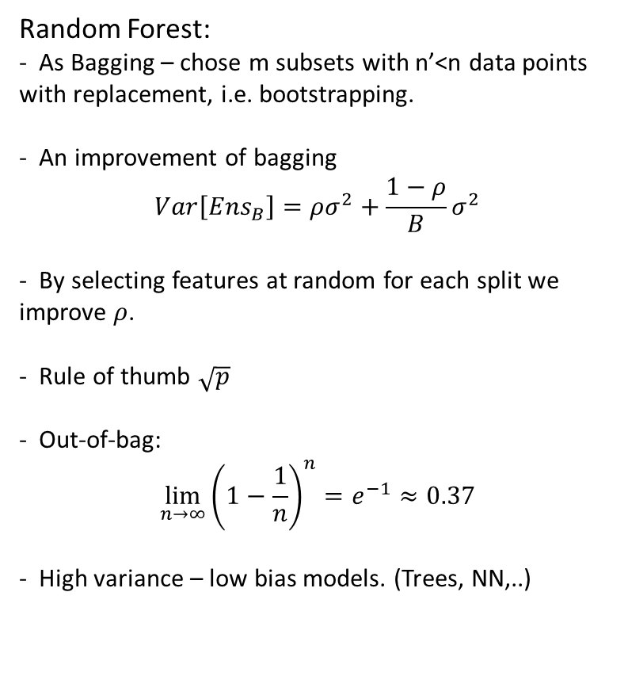
Lecture 6
Random Forest:
- As Bagging – chose m subsets with n’<n data points with replacement, i.e. bootstrapping.
- An improvement of bagging
$$Var\left[Ens_{B}\right]=ρσ^{2}+\frac{1−ρ}{B}σ^{2}$$
- By selecting features at random for each split we improve $ρ$.
- Rule of thumb $\sqrt{p}$
- Out-of-bag:
$$\lim_{n→∞}{{\left(1−\frac{1}{n}\right)}^{n}}=e^{−1}≈0.37$$
- High variance – low bias models. (Trees, NN,..)
Build in features of the RF:
Feature importance
OOB by randomize on column and test predictiveness
Avg reduction in empirical risk per feature
Proximity
Can be used to get an idea of sample similarity
Can be used to fill out missing data
Very hard to overfit

Slide 2
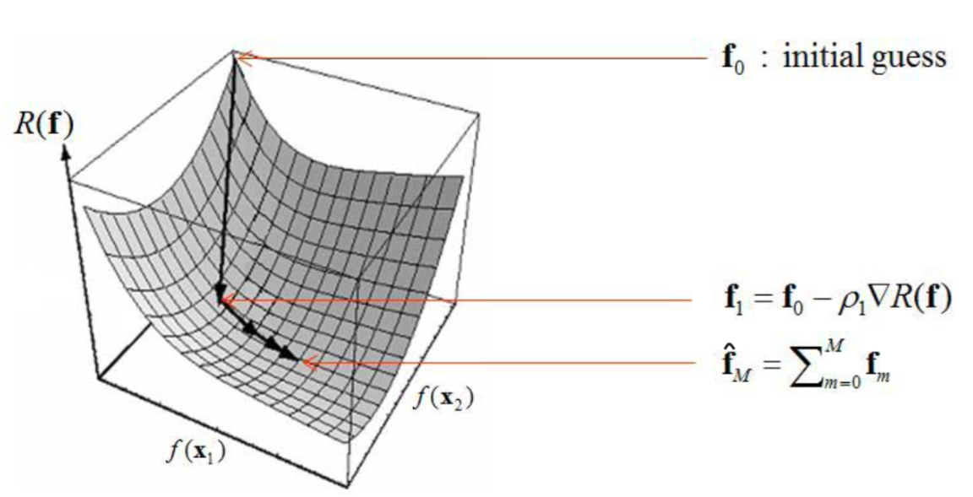
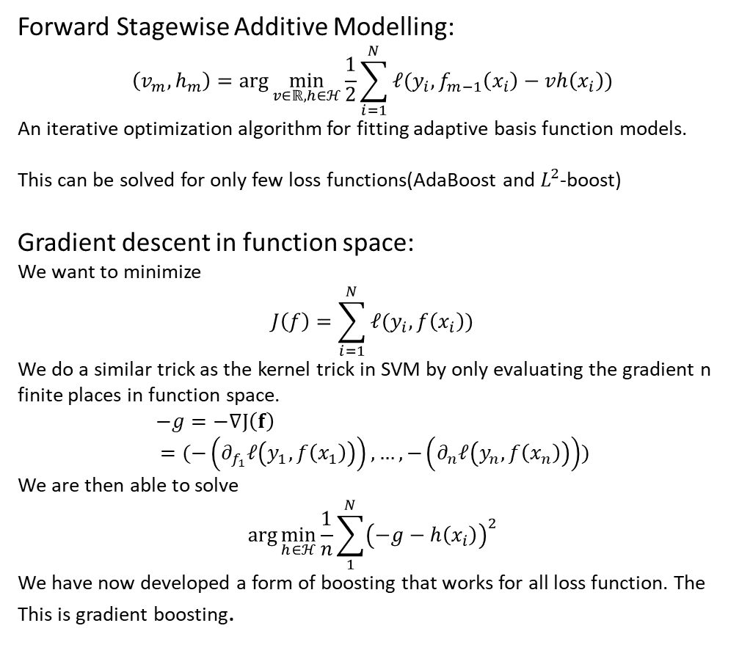
Lecture 6
Forward Stagewise Additive Modelling:
$$\left(v_{m},h_{m}\right)=\arg{\min_{v∈ℝ,h∈ℋ}{\frac{1}{2}\sum_{i=1}^{N}{ℓ(y_{i},f_{m−1}\left(x_{i}\right)−vh\left(x_{i}\right))}}}$$
An iterative optimization algorithm for fitting adaptive basis function models.
This can be solved for only few loss functions(AdaBoost and $L^{2}$-boost)
Gradient descent in function space:
We want to minimize
$$J\left(f\right)=\sum_{i=1}^{N}{ℓ(y_{i},f\left(x_{i}\right))}$$
We do a similar trick as the kernel trick in SVM by only evaluating the gradient n finite places in function space.
$$−g=−∇J\left(f\right) \\ =(−\left(∂_{f_{1}}ℓ\left(y_{1},f\left(x_{1}\right)\right)\right),…,−\left(∂_{n}ℓ\left(y_{n},f\left(x_{n}\right)\right)\right))$$
We are then able to solve
$$\arg{\min_{h∈ℋ}{\frac{1}{n}\sum_{1}^{N}{{\left(−g−h\left(x_{i}\right)\right)}^{2}}}}$$
We have now developed a form of boosting that works for all loss function. The This is gradient boosting.
Boosting:
Sequential ensemble that shrinks both variance and bias -> Stumps are preferable.
Can overfit -> Regularize by step size and tree size(stumps)
AdaBoost is weak, exp loss -> dies on large Bayes error, outliers and wrongly labeled data
Takes time to train due to sequential nature. Not parallelizable.
If used for tree -> poor extrapolation
Notes:
FSAM, f0=0

